Slide 1
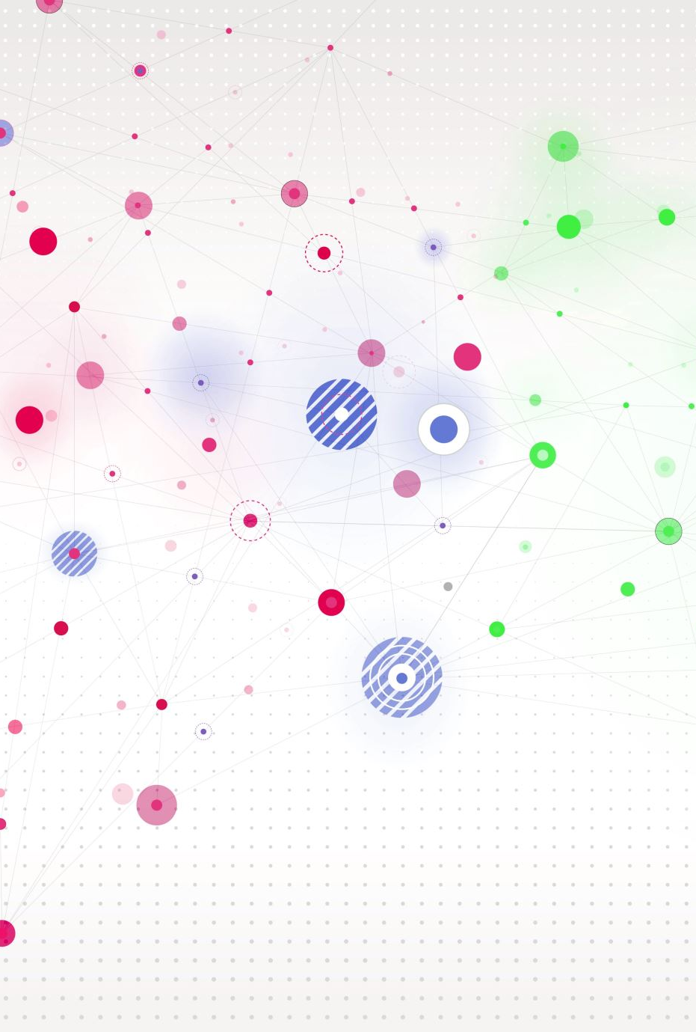
Pipelining Hazards

Slide 2

Pipeline Hazards
A pipeline hazard occurs when the pipeline, or some portion of the pipeline, must stall because conditions do not permit continued execution.
A stall can be described as a cycle without new input in the pipeline.
In other words, we can say that the stall will happen when the later instruction depends on the output of the earlier instruction.
There are three types of hazards:
Resource/Structural Hazards
Data Hazards
Control Hazards

Slide 3
Resource/Structural Hazards
A resource hazard occurs when two (or more) instructions that are already in the pipeline need the same resource.
The result is that the instructions must be executed in serial rather than parallel for a portion of the pipeline.
A resource hazard is sometime referred to as a structural hazard.

Slide 4
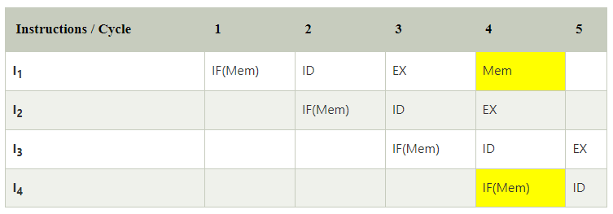
Resource/Structural Hazards (Example)
The table contains the four instructions I₁, I₂, I₃, and I₄, and five cycles 1, 2, 3, 4, 5.
In cycle 4, there is a resource conflict because I₁ and I₄ are trying to access the same resource. In our case, the resource is memory.
The solution to this problem is that we have to keep the instruction on wait as long as the required resource becomes available.
Because of this wait, the stall will be introduced in pipelines like this:

Slide 5
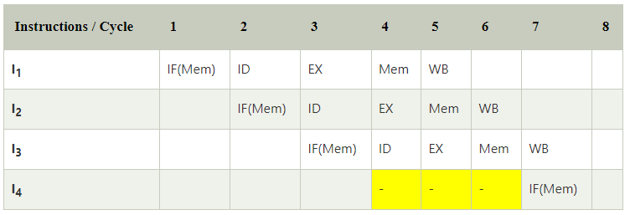
Resource/Structural Hazards (Example)
The table contains the four instructions I₁, I₂, I₃, and I₄, and five cycles 1, 2, 3, 4, 5.
In cycle 4, there is a resource conflict because I₁ and I₄ are trying to access the same resource. In our case, the resource is memory.
The solution to this problem is that we have to keep the instruction on wait as long as the required resource becomes available.
Because of this wait, the stall will be introduced in pipelines like this:

Slide 6
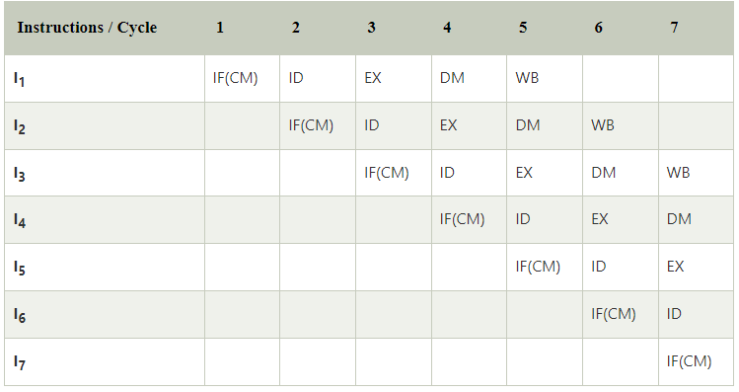
Solutions for Structural dependency
(Renaming)
In this mechanism, the memory will be divided into two independent modules, which are known as Data memory (DM) and Code memory (CM).
Here, all the instructions are contained with the help of CM, and all the operands which are required for the instructions are contained by the DM.

Slide 7
Control Hazard or Branch Hazard
When we transfer the control instructions, the control dependency will occur at that time.
These instructions can be JMP, CALL, BRANCH, and many more.
On many instruction architectures, when the processor wants to add the new instruction into the pipeline, the processor does not know the target address of these new instructions. Because of this drawback, unwanted instructions are inserted into the pipeline.

Slide 8
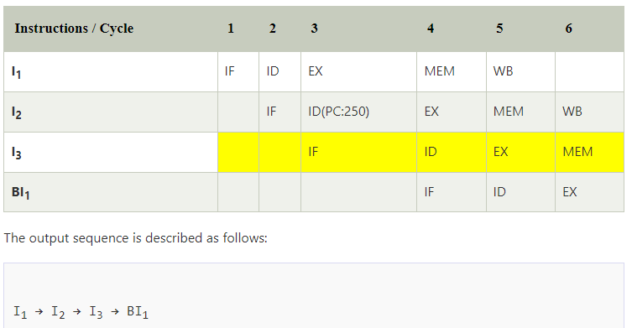
Control Hazard (Example)
For this, we will assume a program and take the following sequence of instructions like this:
100: I₁
101: I₂
102: I₃
.
.
250: BI₁
Expected Output is described as follows:
I₁ → I₂ → BI₁

Slide 9
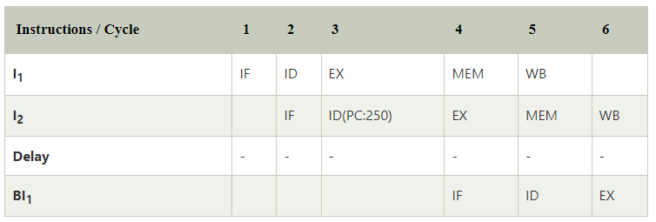
Control Hazard (Example contd…)
So, the above example shows that the expected output and output sequence are not equal to each other. It shows that the pipeline is not correctly implemented.
We can correct that problem with the help of stopping the instruction fetch as long as we get the target address of branch instruction. For this, we will implement the delay slot as long as we get the target address, which is described in the following table:
The output sequence is described as follows:
I₁ → I₂ → Delay (Stall) → BI₁
In the above example, we can see that there is no operation performed by the delay slot. That's why this output sequence, and the expected output are not equal to each other. But because of this slot, a stall will be introduced in the pipeline.

Slide 10
Solution for Control Hazards
In the control dependency, we can eliminate the stall in the pipelines with the help of a method known as Branch prediction. The prediction about which branch will be taken is done at the 1st stage of branch prediction. The branch prediction contains the 0-branch penalty.
Branch Penalty: Branch penalty can be described as the number of stalls that are introduced at the time of branch operation in the pipeline.
NOTE :
As we see that the target address is available after the ID stage, so the number of stalls introduced in the pipeline is 1.
Suppose, the branch target address would have been present after the ALU stage, there would have been 2 stalls.
Generally, if the target address is present after the k^{th} stage, then there will be (k – 1) stalls in the pipeline.
Total number of stalls introduced in the pipeline due to branch instructions = Branch frequency * Branch Penalty

Slide 11
Data Hazards
A data hazard occurs when there is a conflict in the access of an operand location.
In other word, Data hazards: an instruction cannot continue because it needs a value that has not yet been generated by an earlier instruction
Read after write (RAW), or true dependency
Write after read (WAR), or anti dependency
Write after write (WAW), or output dependency

Slide 12
Types of Data Hazards
Read after write (RAW), or true dependency
An instruction modifies a register or memory location
Succeeding instruction reads data in memory or register location
Hazard occurs if the read takes place before write operation is complete
It occurs when the value produced by an instruction is required by a subsequent instruction.
Example :
ADD R1, --, --;
SUB --, R1, --;

Slide 13
Types of Data Hazards (contd..)
Write after read (WAR), or Antidependency
An instruction reads a register or memory location
Succeeding instruction writes to the location
Hazard occurs if the write operation completes before the read operation takes place
These hazards occur when the output register of an instruction is used right after read by a previous instruction
Example:
ADD --, R1, --;
SUB R1, --, --;

Slide 14
Types of Data Hazards (contd..)
Write after write (WAW), or output dependency
Two instructions both write to the same location.
Hazard occurs if the write operations take place in the reverse order of the intended sequence.
These hazards occur when the output register of an instruction is used for write after written by previous instruction
Example :
ADD R1, --, --;
SUB R1, --, --;

Slide 15
Types of Data Hazards (contd..)
Read after Read (RAR)
It occurs when the instruction both read from the same register.
For example,
Since reading a register value does not change the register value, these Read after Read (RAR) hazards don’t cause a problem for the processor.
ADD --, R1, --;
SUB --, R1, --;

Slide 16
Multiple Streams
A simple pipeline suffers a penalty for a branch instruction because it must choose one of two instructions to fetch next and may make the wrong choice
A brute-force approach is to replicate the initial portions of the pipeline and allow the pipeline to fetch both instructions, making use of two streams
Drawbacks (disadvantage):
With multiple pipelines there are contention delays for access to the registers and to memory
Additional branch instructions may enter the pipeline before the original branch decision is resolved

Slide 17
Prefetch Branch Target
When a conditional branch is recognized, the target of the branch is prefetched, in addition to the instruction following the branch
Target is then saved until the branch instruction is executed
If the branch is taken, the target has already been prefetched

Slide 18
Branch Prediction
Various techniques can be used to predict whether a branch will be taken:
Static approaches
They do not depend on the execution history up to the time of the conditional branch instruction
1. Predict never taken
2. Predict always taken
3. Predict by opcode
Dynamic approaches
They depend on the execution history
1. Taken/not taken switch
2. Branch history table

Slide 19
Handling Data Hazards :
These are various methods we use to handle hazards: Forwarding, Code recording, and Stall insertion. These are explained as follows below.
Forwarding :
It adds special circuitry to the pipeline. This method works because it takes less time for the required values to travel through a wire than it does for a pipeline segment to compute its result.
Code reordering :
We need a special type of software to reorder code. We call this type of software a hardware-dependent compiler.
Stall Insertion :
it inserts one or more installs (no-op instructions) into the pipeline, which delays the execution of the current instruction until the required operand is written to the register file, but this method decreases pipeline efficiency and throughput.

Slide 20
Numerical
Q. Consider an instruction pipeline with five stages without any branch prediction: Fetch Instruction (FI), Decode Instruction (DI), Fetch Operand (FO), Execute Instruction (EI) and Write Operand (WO). The stage delays for FI, DI, FO, EI and WO are 5 ns, 7 ns, 10 ns, 8 ns and 6 ns, respectively. There are intermediate storage buffers after each stage and the delay of each buffer is 1 ns. A program consisting of 12 instructions I1, I2, I3, …, I12 is executed in this pipelined processor. Instruction I4 is the only branch instruction, and its branch target is I9. If the branch is taken during the execution of this program, the time (in ns) needed to complete the program is ………………….
Q.

Slide 21
